Slide 1
Introduction to Apache Kafka

Slide 2
Table of Contents
Overview
Replication
Why kafka is so Fast!!
Why do need Kafka
Replication
Zookeeper Overview
What is Kafka
Demo!
Demo!
Where it is used in Zeta

Slide 3
Overview
Apache Kafka is a realtime publish-subscribe based durable messaging system
Process streams of records as they occur.
Store streams of records in a fault-tolerant durable way.
Maintains FIFO order for streams
It is a high-throughput, highly distributed, fault-tolerant platform developed by linkedin and written in Scala and Java

Slide 4
Why do we need Kafka?

Slide 5
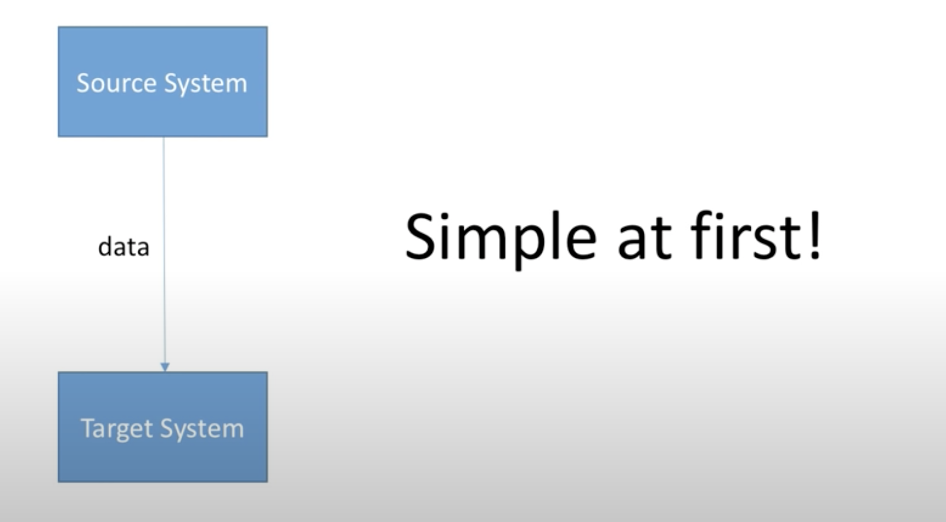
How company starts

Slide 6
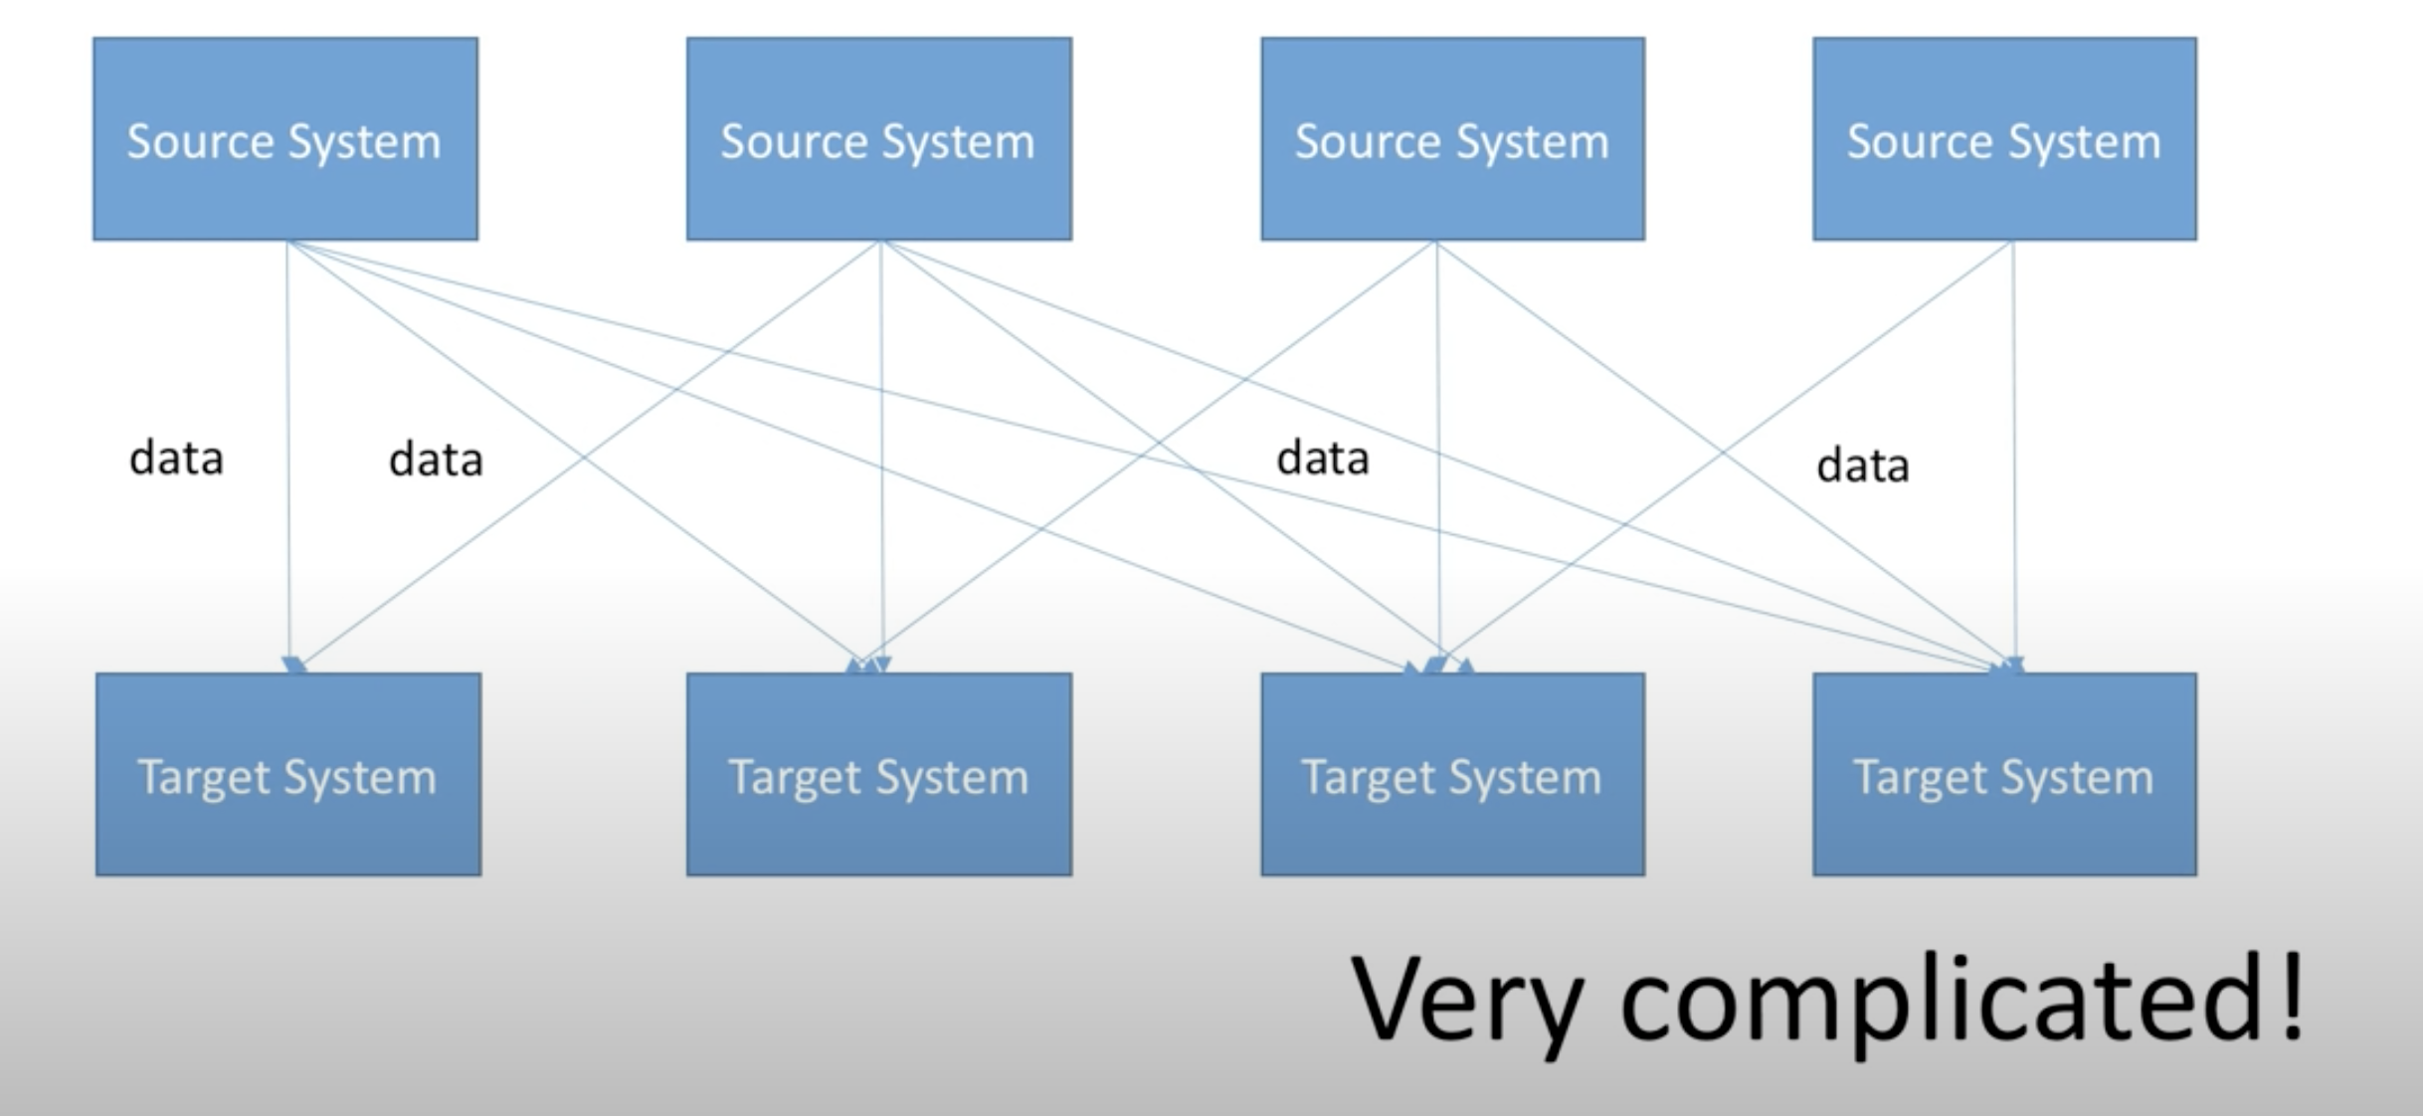
After a while..

Slide 7
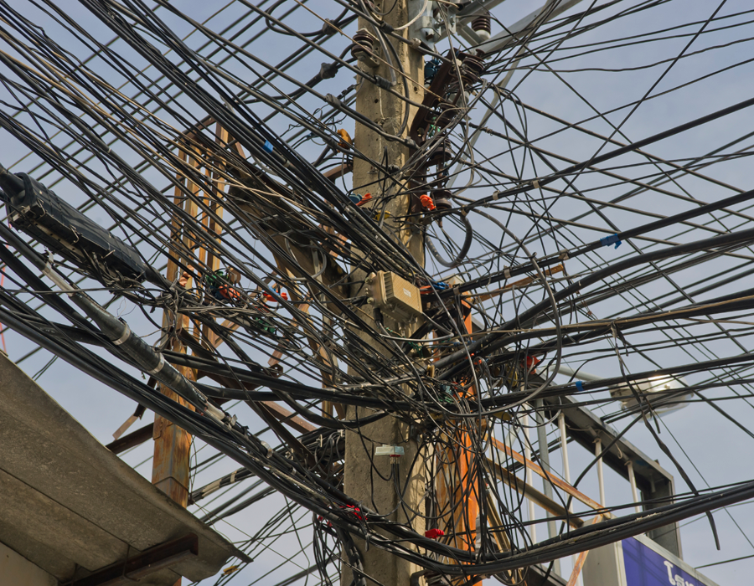

Slide 8
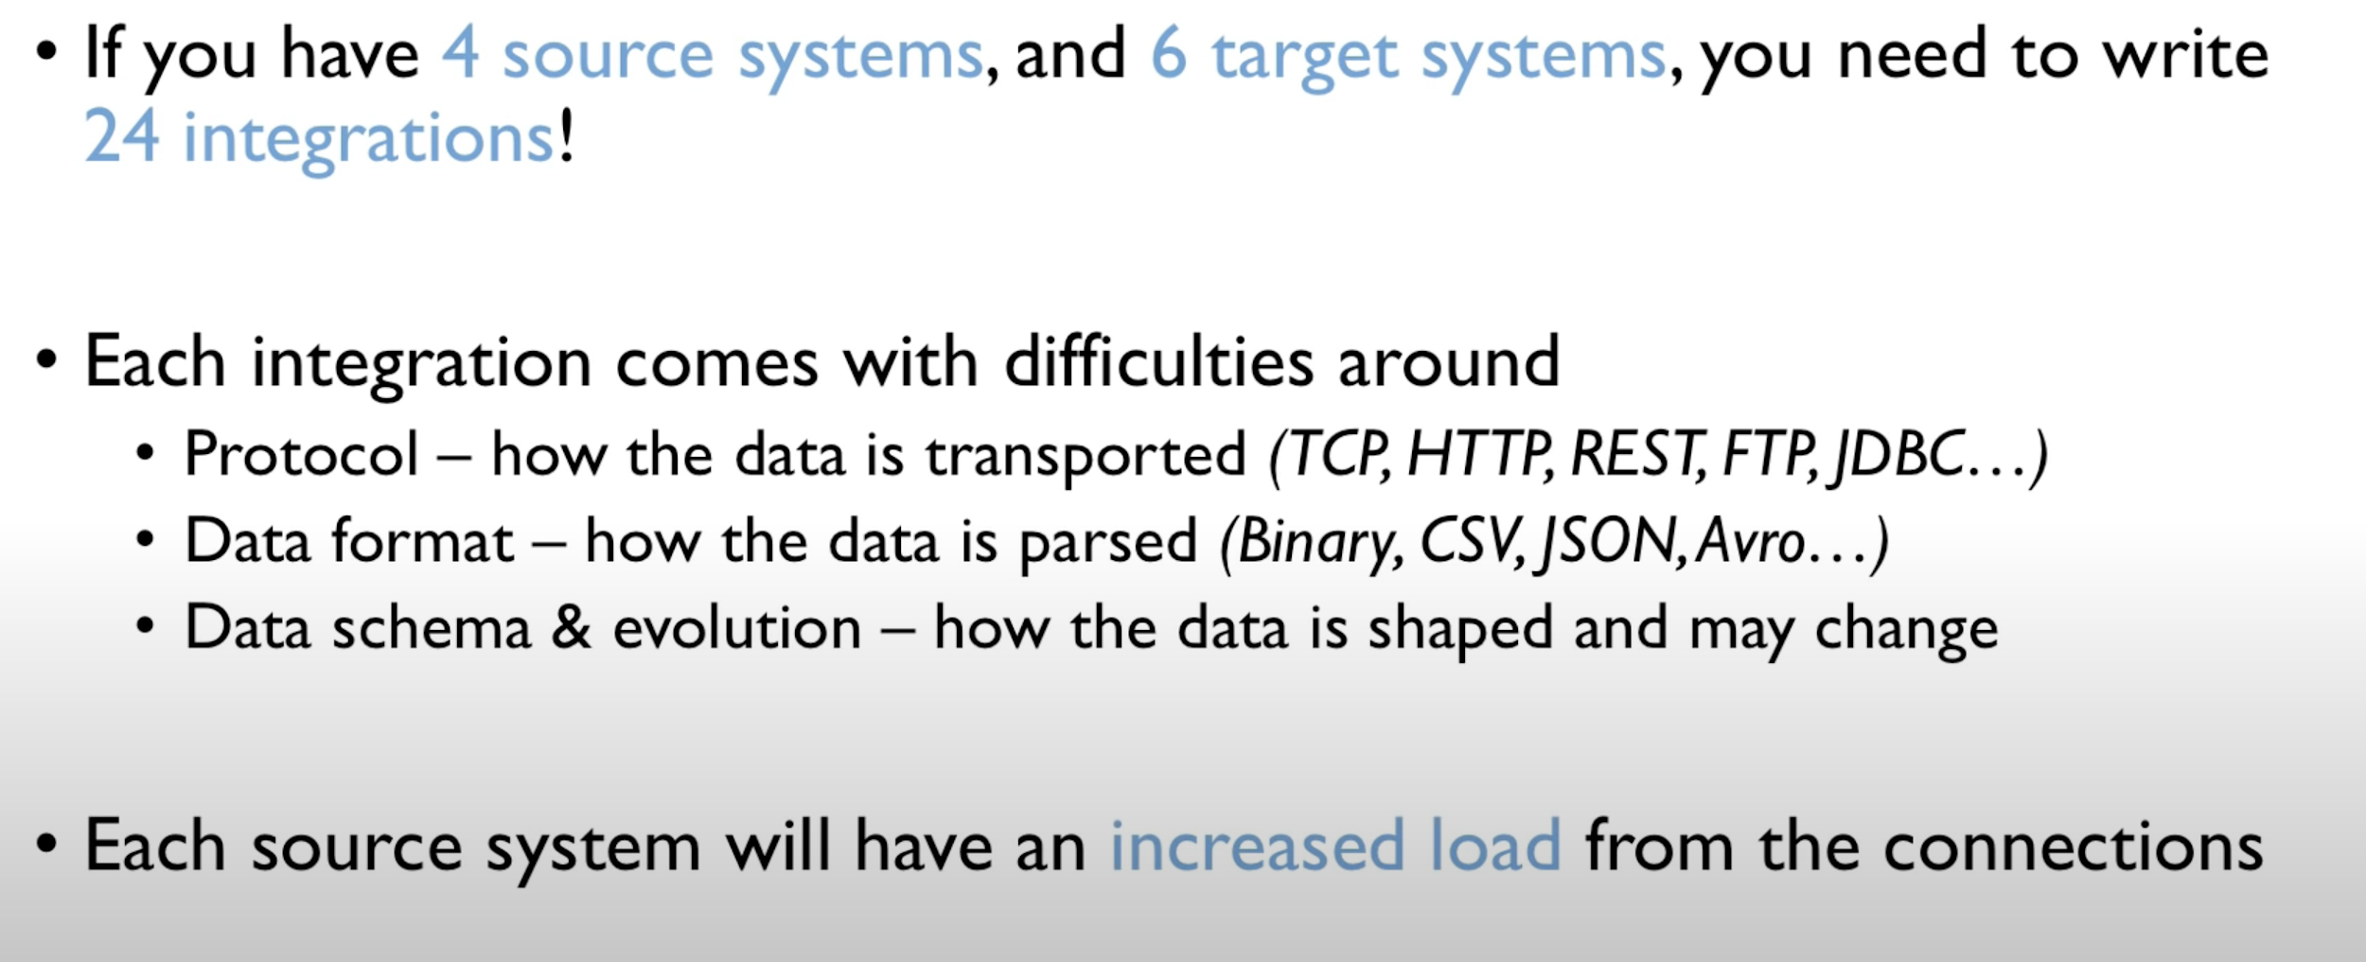
Problems with previous architecture

Slide 9
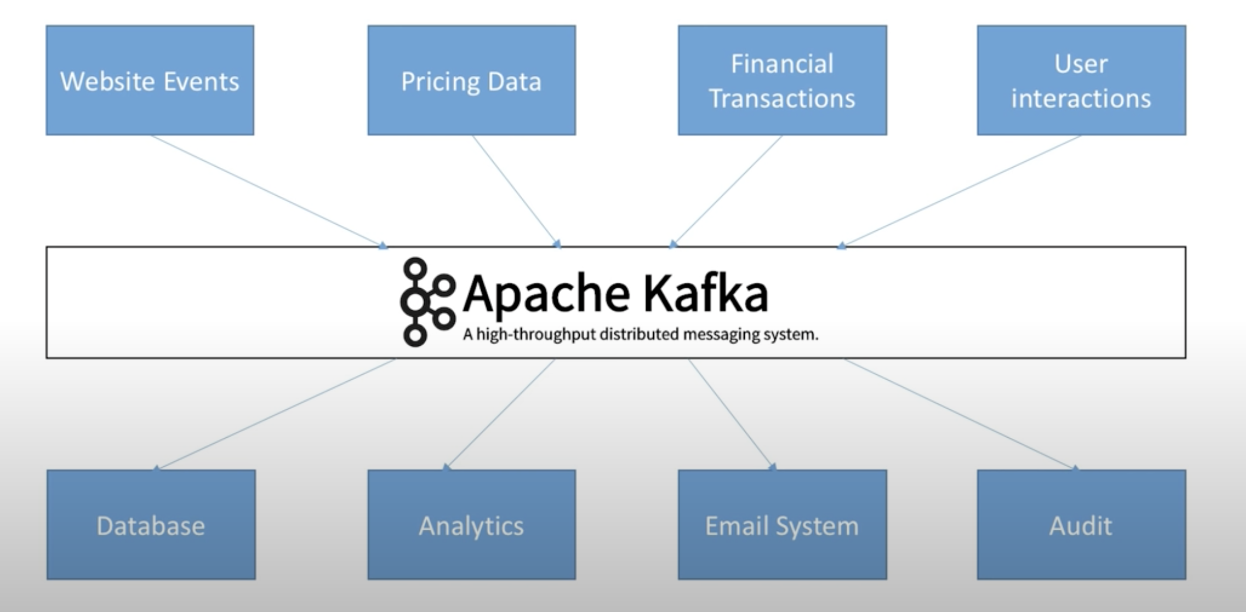
What we’d really like

Slide 10
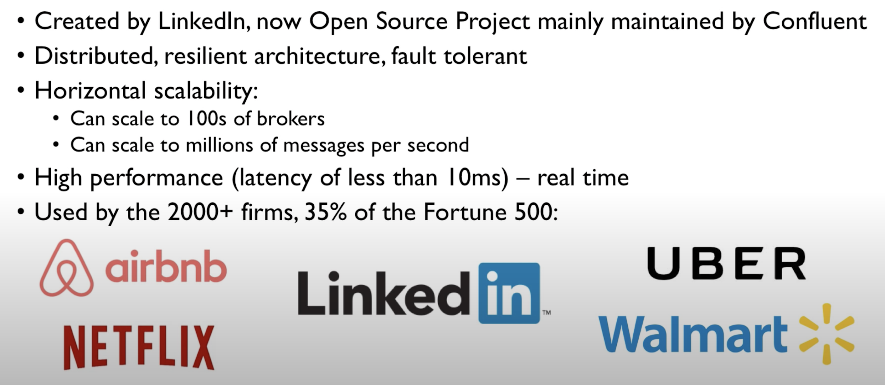
Why Apache Kafka

Slide 11
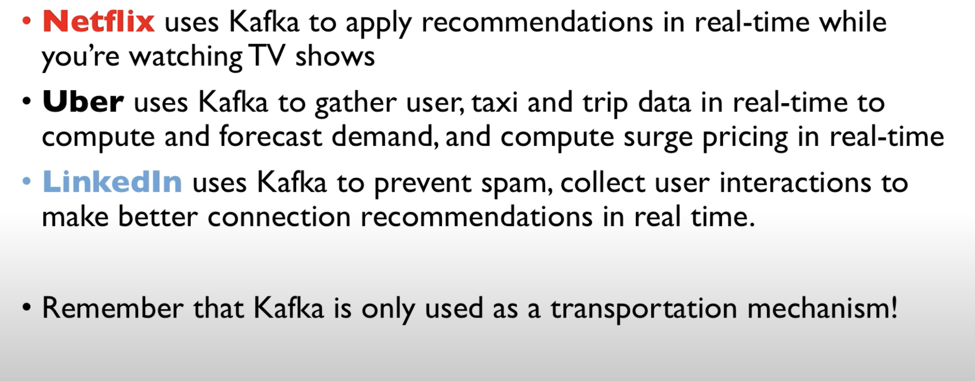
Kafka use cases

Slide 12
How Kafka works?

Slide 13
Kafka components
12
These are four main parts in a Kafka system:
Producer: Sends records to a broker.
Broker: Handles all requests from clients (produce, consume, and metadata) and keeps data replicated within the cluster. There can be one or more brokers in a cluster.
Consumer: Consumes batches of records from the broker.
Zookeeper: Keeps the state of the cluster (brokers, topics, users, offset).

Slide 14
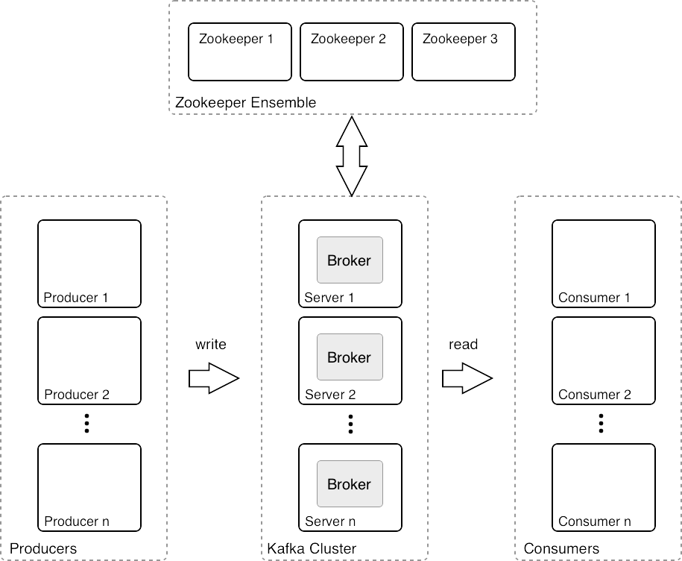
Architecture
8

Slide 15
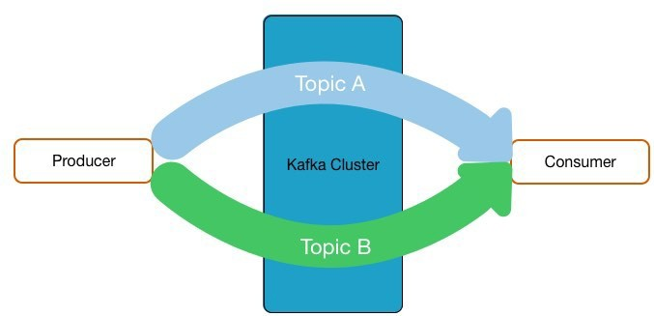
Topics
12
Streams of “related” Messages in Kafka
Is a Logical Representation
Categorizes Messages into Groups
Developers define Topics
Producer write data to topics and consumer read from topics
Ex - User_View, User_ Click, Order_created, Product_Updated,

Slide 16
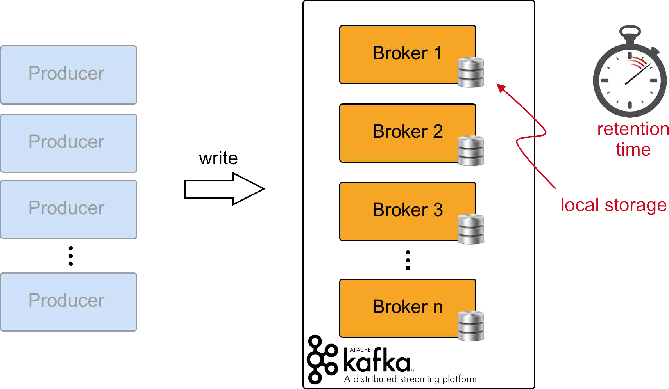
Kafka Brokers
6
Topic 1
Topic 2
Topic n

Slide 17
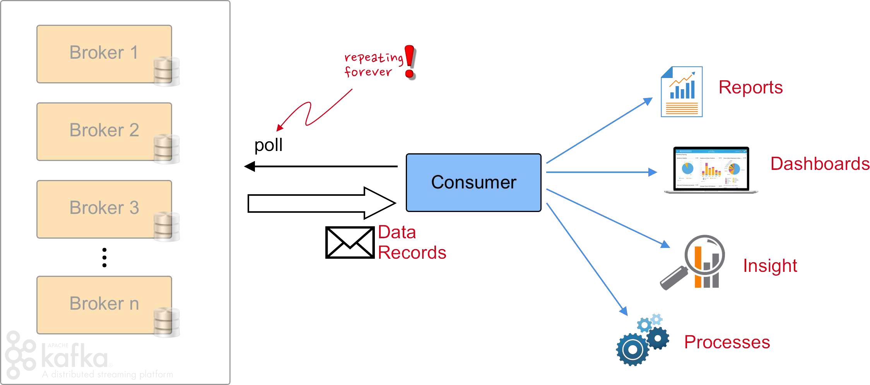
Consumers
7

Slide 18
Consumer Basics
24
Consumers pull messages from 1..n topics
New inflowing messages are automatically retrieved
Consumer will always read from leader
Consumer committed offset - Keeps track of the last message committed
Consumer current offset - Keeps track of the last message read

Slide 19
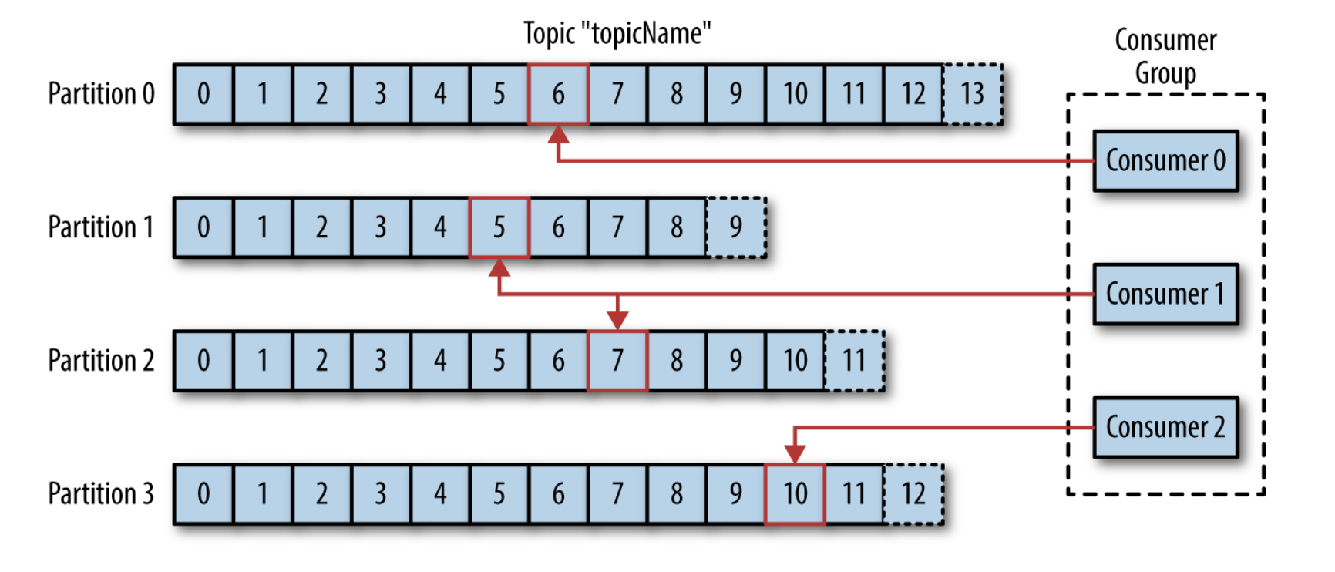
Producer writes here
Lag = 7
Consumer Example

Slide 20
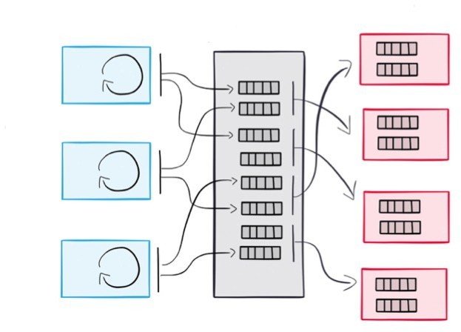
Decoupling Producers and Consumers
9
Producers and Consumers are decoupled
Slow Consumers do not affect Producers
Add Consumers without affecting Producers
Failure of Consumer does not affect System

Slide 21
How do you scale a topic?

Slide 22
Partitions
12
To scale a particular topic, topics are further broken up into several partitions, usually by record key if the key is present.
Each partition can run its own consumer in a single consumer group
Each partition consumer combination will maintain its own offset
Kafka can replicate partitions to multiple Kafka Brokers.
Partitioning Strategy specified by Producer
Default Strategy: hash(key) % number_of_partitions
No Key Round-Robin

Slide 23
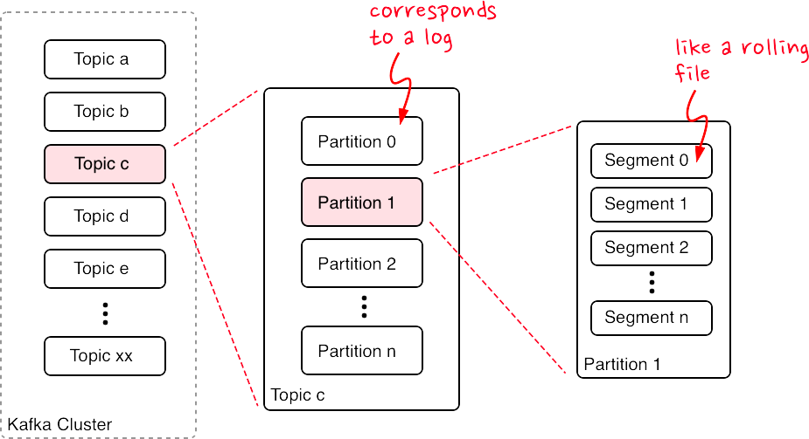
Topics, Partitions, and Segments
13

Slide 24
Producer writes here
Lag = 7
Consumer Example

Slide 25
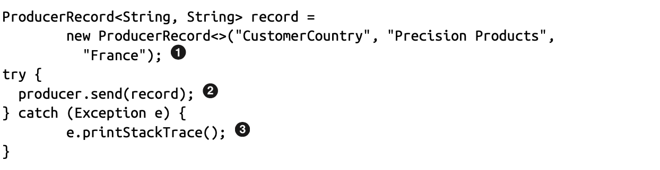
Typical Producer API

Slide 26
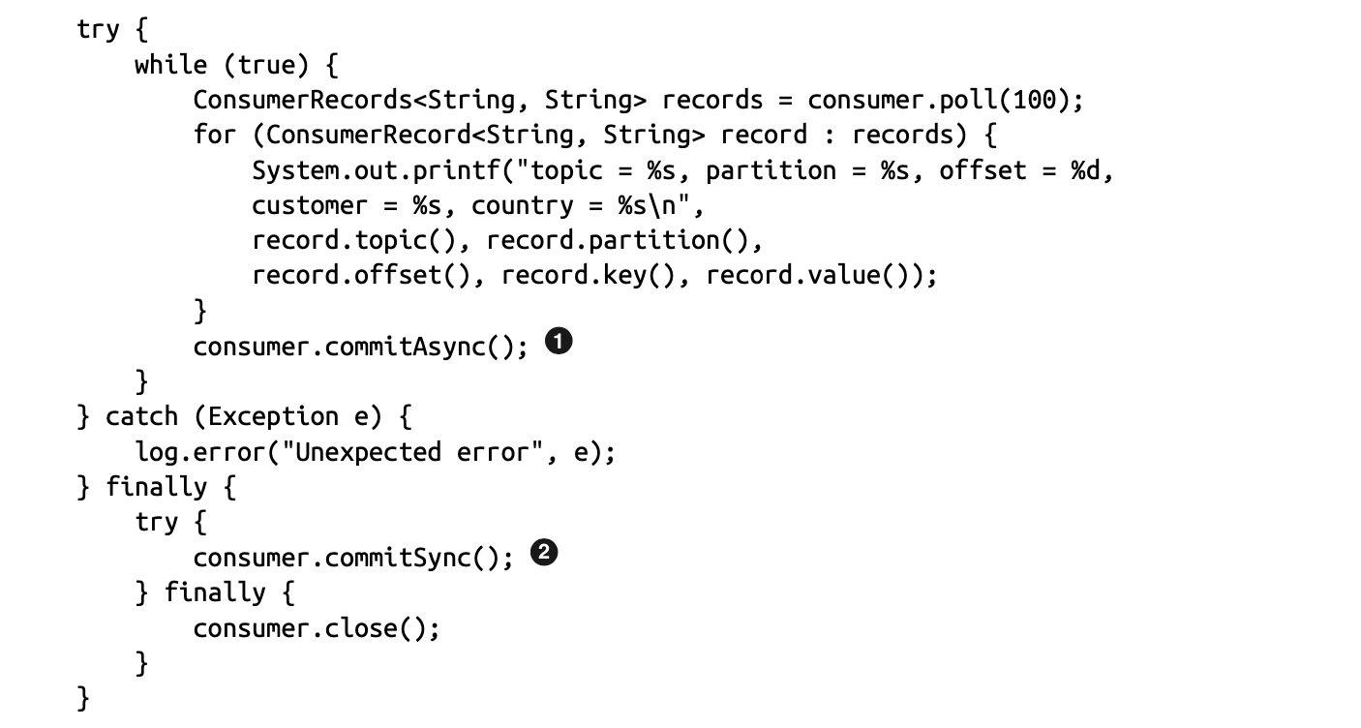
Typical Consumer API

Slide 27
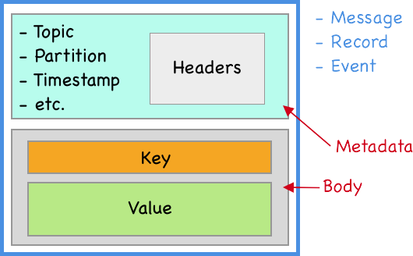
Data Elements
18

Slide 28
Consumers with Partitions
13
Single consumer can read multiple partitions
If consumer instances are more than partitions for a topic, then there will be no use of extra consumer instances.
What if we want to consume a partition data from multiple services
Ex - We want to update data in table in RDBMS
We want to update in Elasticsearch
We want to update in Recommendation engine

Slide 29
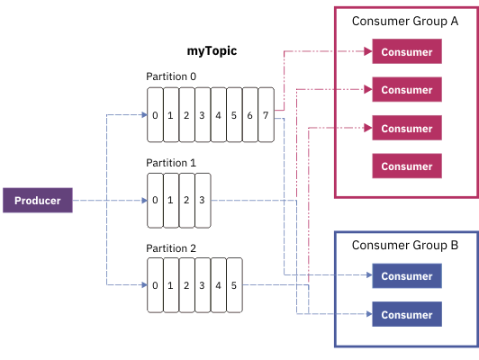
Consumer groups
13
Consumers can be organized into logic consumer groups
Topic -> User Views of Product
Consumer Group A -> Add view in DB
Consumer Group B -> Update data in EL
Consumer Group C -> Send data for recommendation engine

Slide 30
Demo!

Slide 31
Part 2
Notes:
Speak about why replication is needed

Slide 32
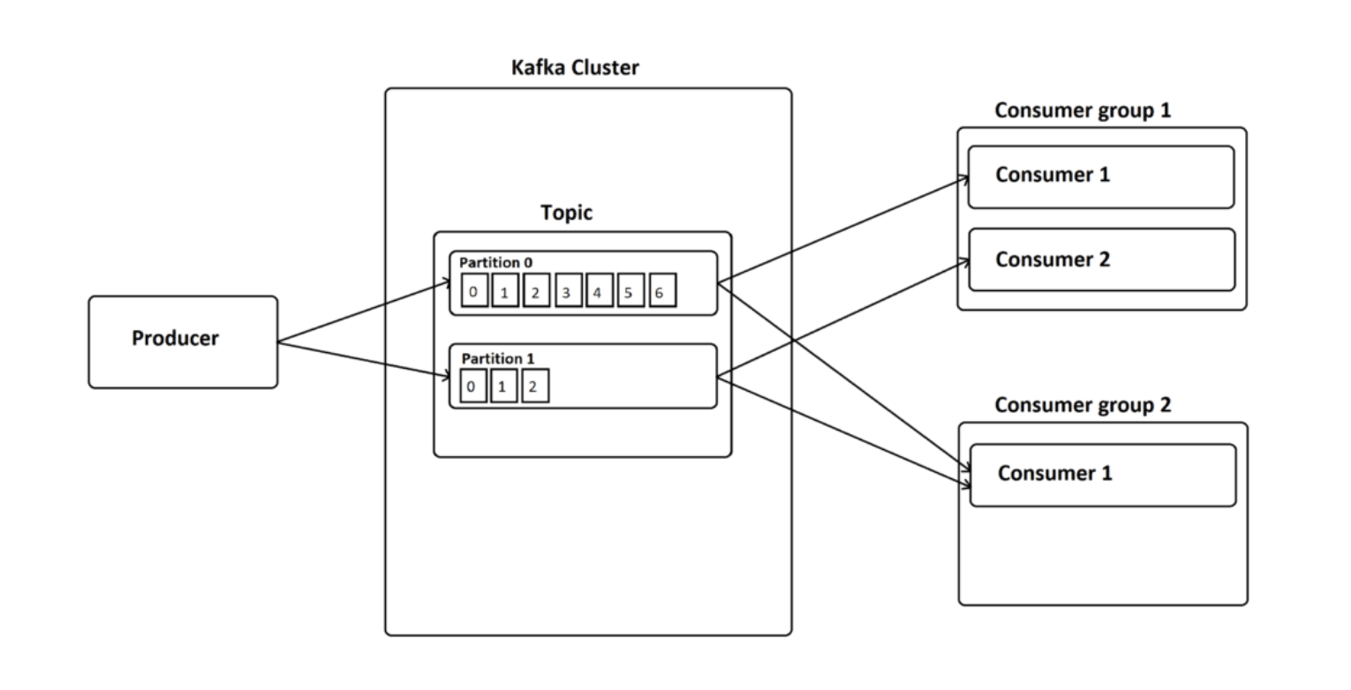
Part1 Summary

Slide 33
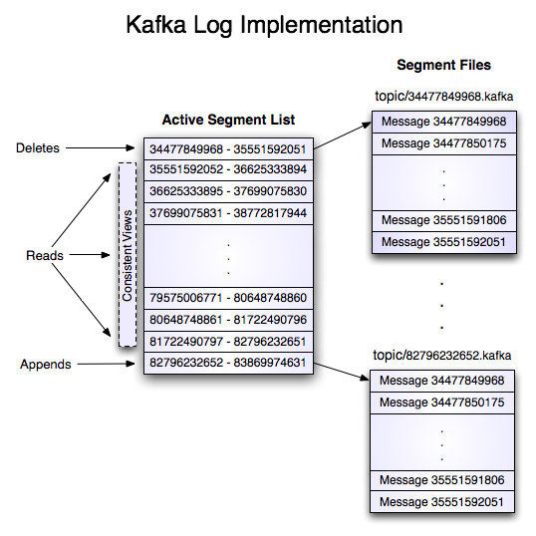
Segments
13
Notes:
Speak about "Why kafka is so fast" as it read and write data sequentially.

Slide 34
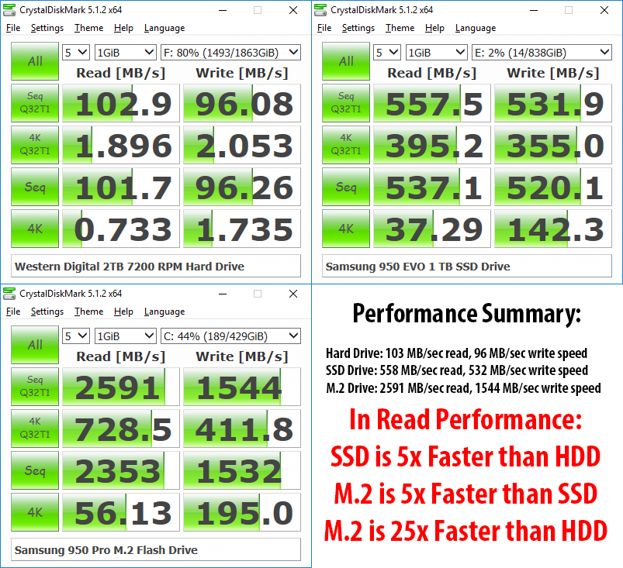
Sequential Vs Random read and write speed

Slide 35
Demo!

Slide 36
Replication
Notes:
Replication is the process of having multiple copies of the data for the sole purpose of availability in case one of the brokers goes down and is unavailable to serve the requests

Slide 37
Why do we need replication
13
Stronger durability
Guarantee that any successfully published message will not be lost
Higher availability
Cluster can still accept message if one or more broker are down
Failures can be caused by machine error, program error and network partitions.

Slide 38
Broker config in cluster
13
There can be multiple brokers in a cluster
Each broker will have unique broker id (broker.id)
Each broker will store data in seperate folder (logs.dir)
Each broker will run on a different port (port)
Default replication factor and partitions for a topic is specified in broker configs
Data retention time params - log.retention.ms

Slide 39
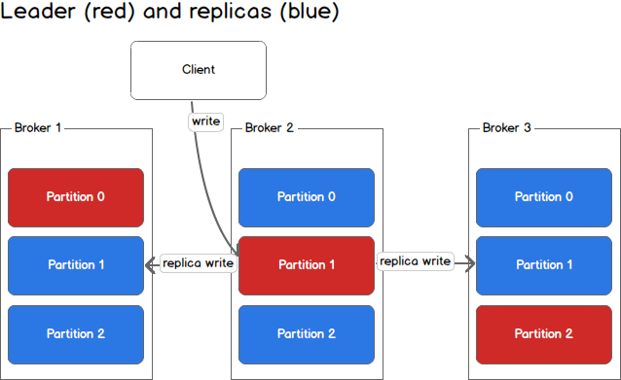
Replication
Replication factor = 3

Slide 40
Replication
13
Replication happens on partition level not topic level
For every partition, there are leader and followers
Partition leaders are evenly distributed among brokers to avoid load on a particular broker
Producer and Consumer both will write and read only on partition leader.
Replica will poll and read from leader regularly
Number of replicas can be specified globally or on topic level

Slide 41
In Sync/Out of Sync replicas
13
Followers replicate data from the leader to themselves by sending fetch Requests periodically, by default every 500ms.
In-Sync Replicas are the replicated partitions that are in sync with its leader
Replicate can go out of sync due to IO limitations, GC or slow network.
The definition of “in-sync” means that a replica is or has been fully caught up with the leader in the last 30 seconds. (replica.lag.time.max.ms and replica.lag.max.messages)
In-sync replicas are the subset of all the replicas for a partition having same messages as the leader

Slide 42
Leader Election
13
https://bravenewgeek.com/tag/leader-election/
Unclean leader election
Unclean leader election flag to allow an out-of-sync replica to become the leader and preserve the availability of the partition.
With unclean leader election, messages that were not synced to the new leader are lost.
This provides balance between consistency (guaranteed message delivery) and availability.
Notes:
Explain controller broker

Slide 43
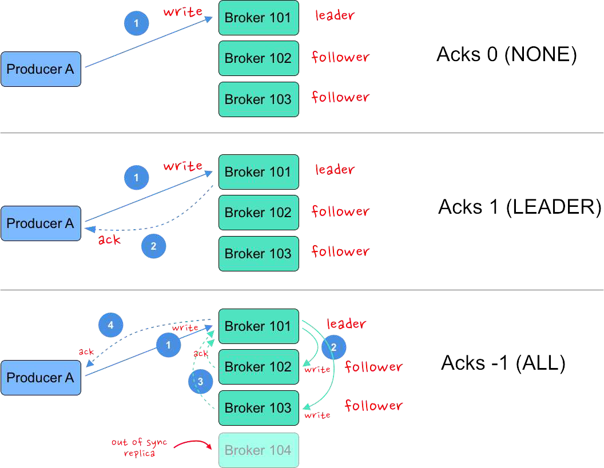
Producer Guarantees
11
Acks = all only needs acks from min In sync replicas

Slide 44
Producer Delivery Semantics
Producers can choose to receive acknowledgements for the data writes to the partition using the “acks” setting. (Default value is 1)
Acks = 0: At most once delivery, No retries!, fire and forget approach, High data loss, Ex - metrics collection, log collection
Acks = 1: At least once, Retry happens in case producer does not get ACK, Moderate data loss, Moderate latency.
Acks = all: acks from all min.insync.replica, exactly once delivery (Yes it is possible! In 0.11.x and later), no data loss, lower throughput and higher latency. Ex- financial applications, IoT applications, and other streaming applications
Command - kafka-console-producer --broker-list localhost:9092,localhost:9093,localhost:9094 --topic demo8 --request-required-acks "all"

Slide 45
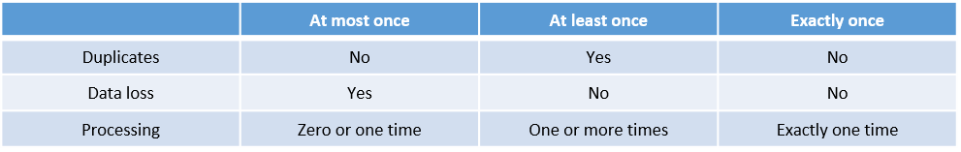
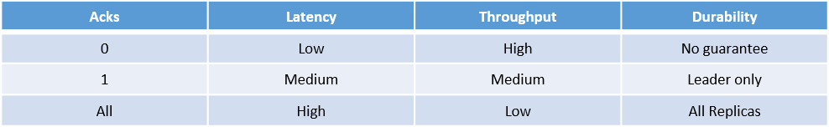
Producer Delivery Semantics

Slide 46
Why Kafka promises atleast once delivery not exactly once?
You can see the two categories of problems that could arise:
1) If the producer app writes to the log but fails to get the acknowledgement back over the network. This would put this producer in a bind: it could be that the write had actually succeed or it could be that it never got to Kafka at all. We don’t know! If we retry and it turns out the write had succeeded we could then have a duplicate; if we don’t retry and it turns out the write hadn’t succeed we’ll lose that write.
2) The second problem comes on the consumer side.
The consumer application could read some messages from the log and write the results to its database, but fail before updating its offset marking its position. When that consumer was restarted (potentially automatically on a different machine using Kafka group management mechanism) that could result in duplicates. If the application updates its stored offset first and then updates the database, the failure could instead lead to missing that update upon restart.

Slide 47
Why Kafka promises atleast once delivery not exactly once?
In order to achieve exactly once delivery, we will have to achieve the following -
1. Message from Producer to Broker should be delivered only once
2. Message should be consumed only once by consumer
Let's see what are the problems we face in order to achieve above

Slide 48
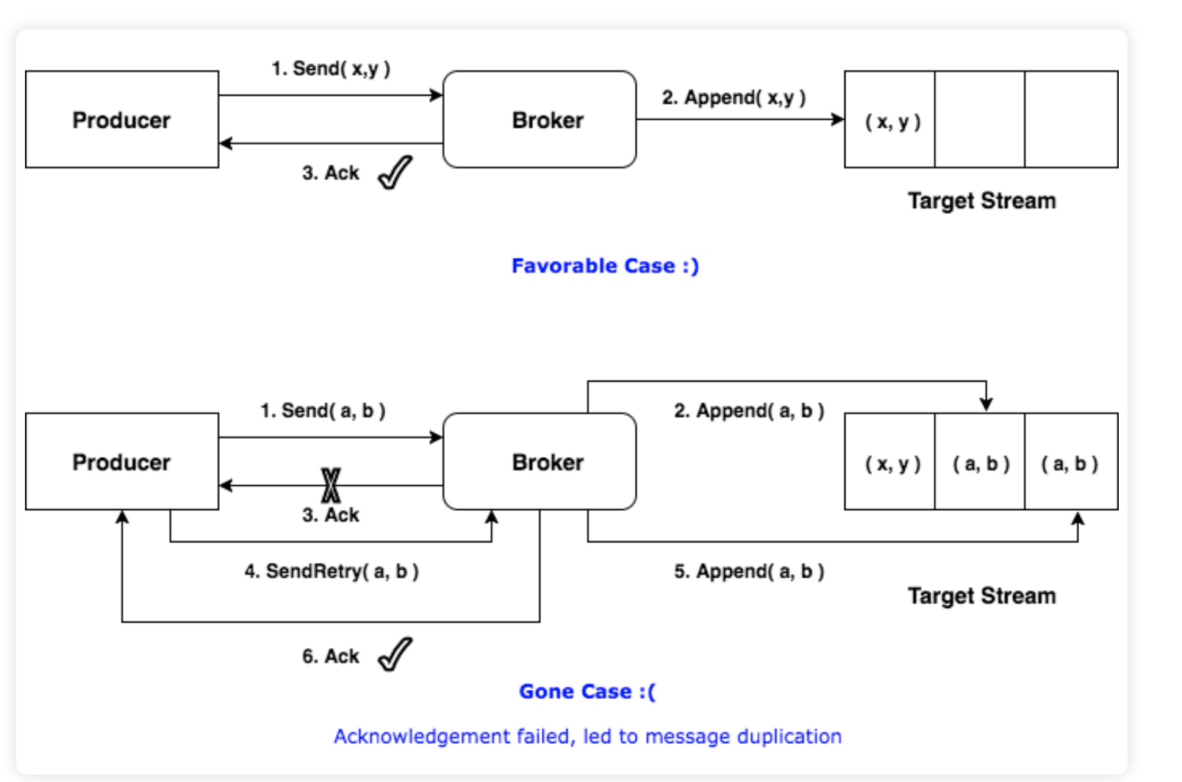
Why kafka promises atleast once delivery not exactly once?
Producer side
Guarantee

Slide 49
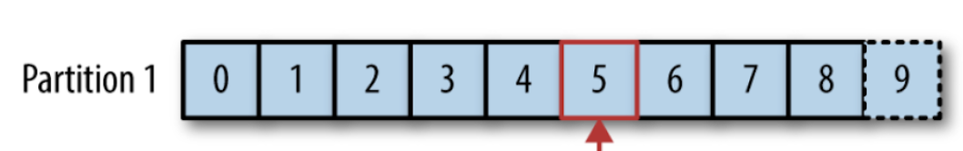
Why kafka promises atleast once delivery not exactly once?
Consumer side
Guarantee

Slide 50
Kafka Topic Properties
13
bin/kafka-topics.sh --zookeeper localhost:2181 --create --topic yourTopicName --partitions 1 --replication-factor 3 --config min.insync.replicas=2
--replication-factor = 3 means data partition data should be present in 1 Leader + 2 Followers
min.insync.replicas specifies the minimum number of replicas that must acknowledge a write in order to consider this write as successful.
min.insync.replicas = 3 means 1 Leader + 2 Followers

Slide 51
Min.insync.replicas and Acks Parameter
13
min.insync.replicas can be specified on creating topics.
min.insync.replicas and acks to “all” (or “-1”) specifies the minimum number of replicas that must acknowledge a write in order to consider this write as successful
If this minimum cannot be met, then the producer will raise an exception (either NotEnoughReplicas or NotEnoughReplicasAfterAppend).
min.insync.replicas and acks allow you to enforce greater durability guarantees. A typical scenario would be to create a topic with a replication factor of 3, set min.insync.replicas to 2, and produce with acks of “all”. This will ensure that the producer raises an exception if a majority of replicas do not receive a write.

Slide 52
Demo!

Slide 53
More to explore
13
Producer design
Consumer properties
Why Kafka is so Fastt

Slide 54
References
13
https://book.huihoo.com/pdf/confluent-kafka-definitive-guide-complete.pdf
https://docs.cloudera.com/documentation/kafka/latest/topics/kafka_ha.html
https://kafka.apache.org/documentation.html#replication
https://bravenewgeek.com/tag/leader-election/
https://www.confluent.io/blog/exactly-once-semantics-are-possible-heres-how-apache-kafka-does-it

